Slide 1
Jennifer Neville
'Rules for Design': Beauty and Grace in Caroso's Choreographies (2007)
Dance Patterns of the Early Seventeenth Century: The Stockholm Manuscript and "Le Ballet de Monseigneur de Vendosme“ (2000)

Slide 2
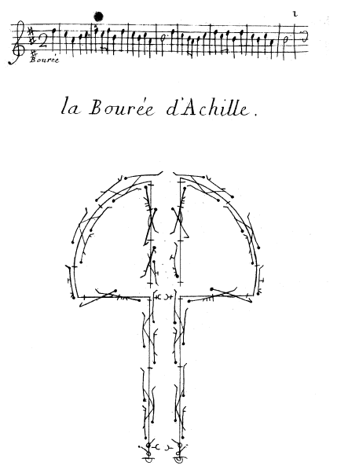
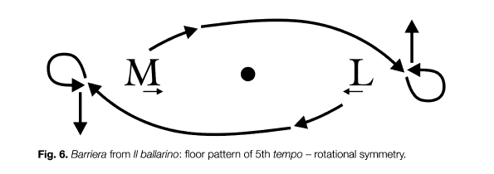

Slide 3
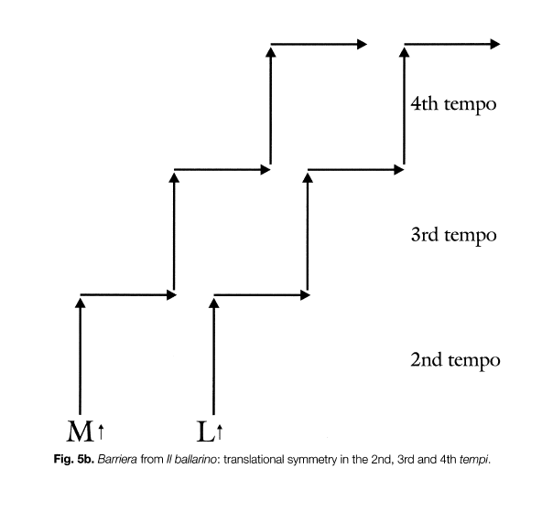

Slide 4
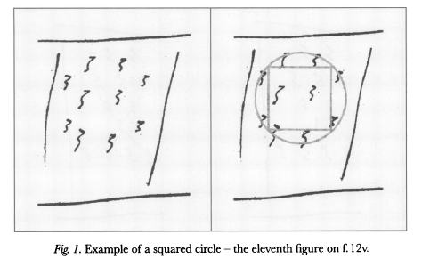

Slide 5
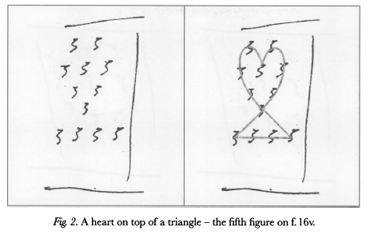

Slide 6
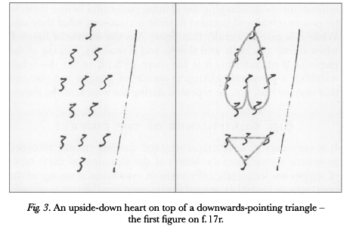

Slide 7
